Slide 1
FS 1, Polder 35/3 7 March 2023
Salt water intrusion blocked by clay barrier

Slide 2
Overview FS 1

Slide 3
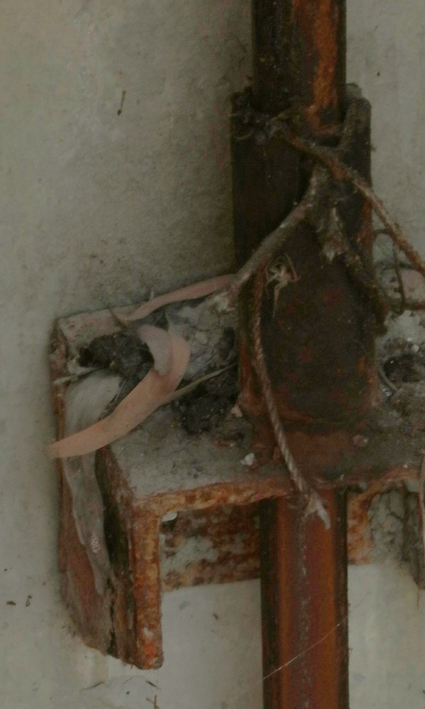
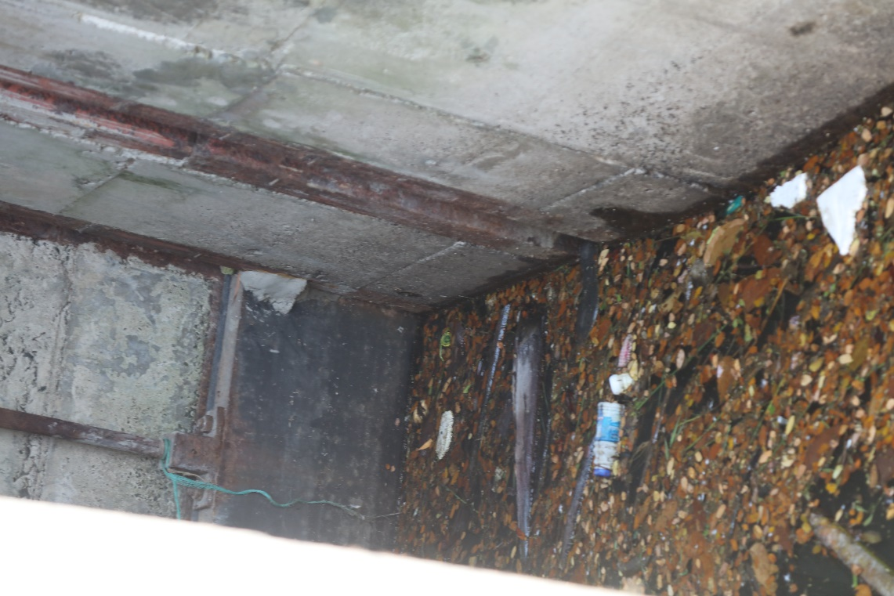
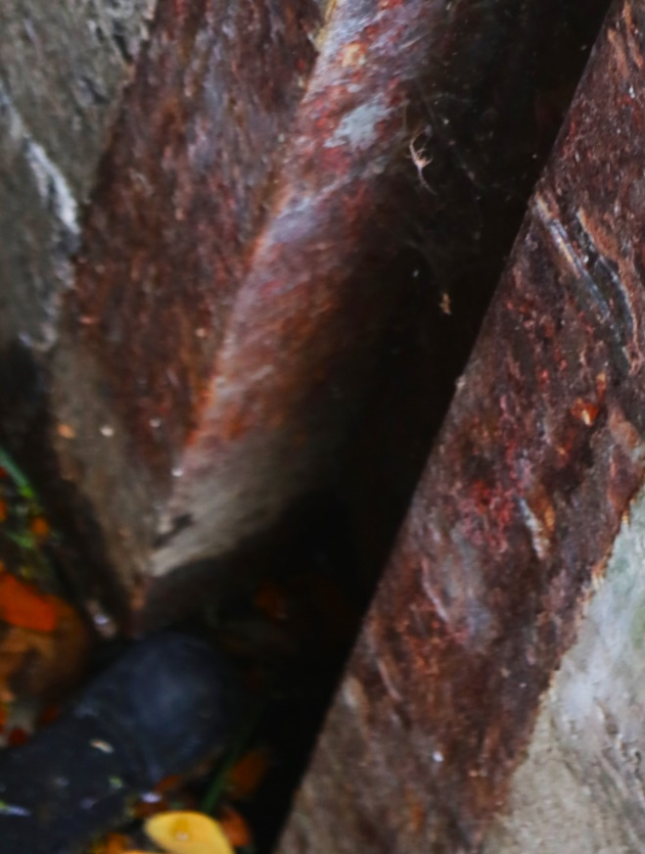
Countryside Liftgate

Slide 4
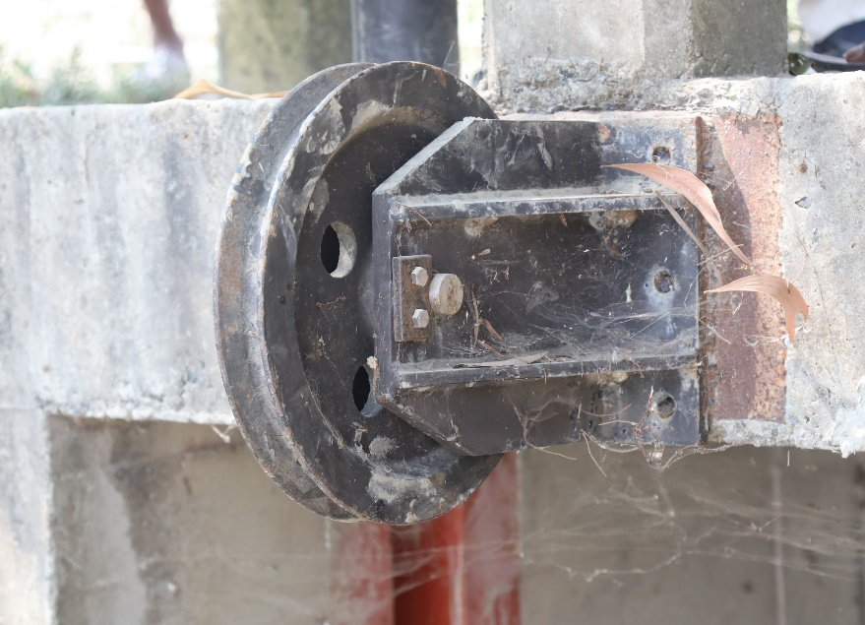
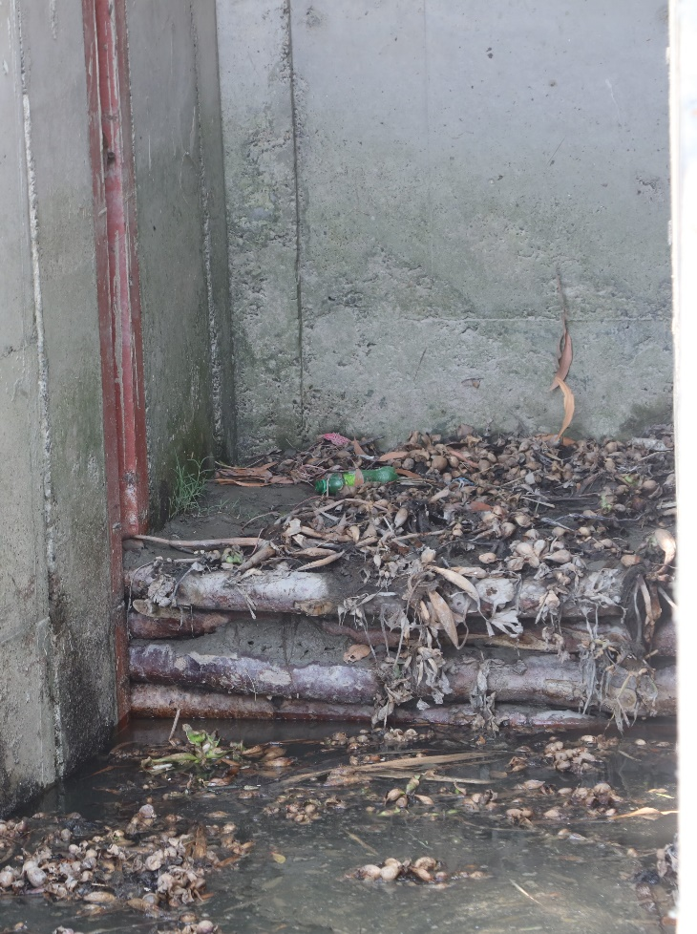
Riverside

Slide 5
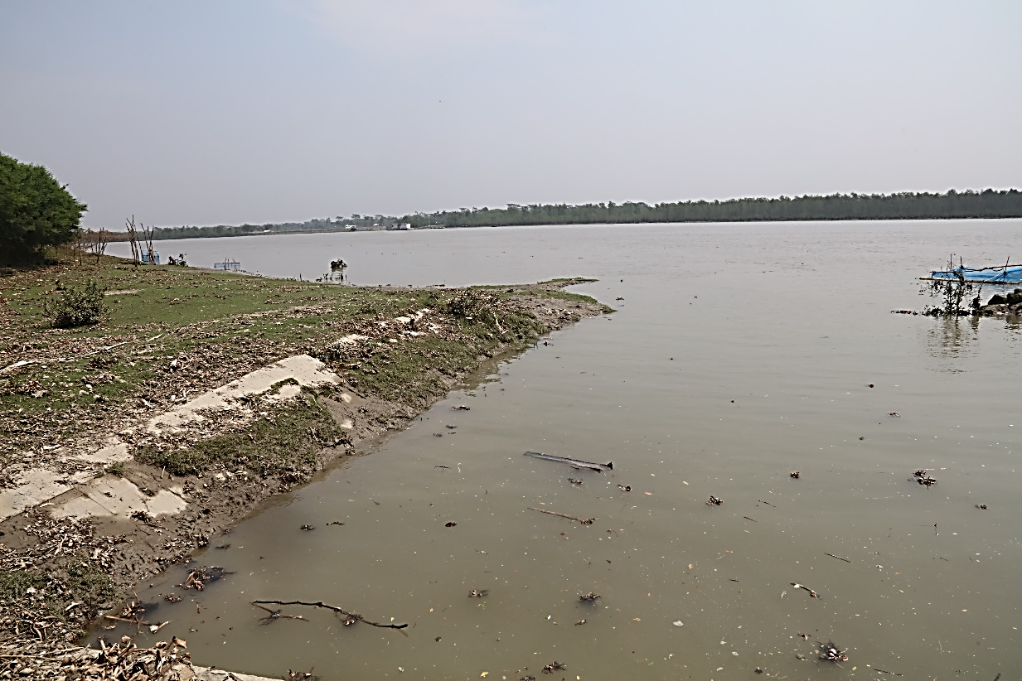
Riverside Slope Protection

Slide 6
Country Side Slope Protection

Slide 7
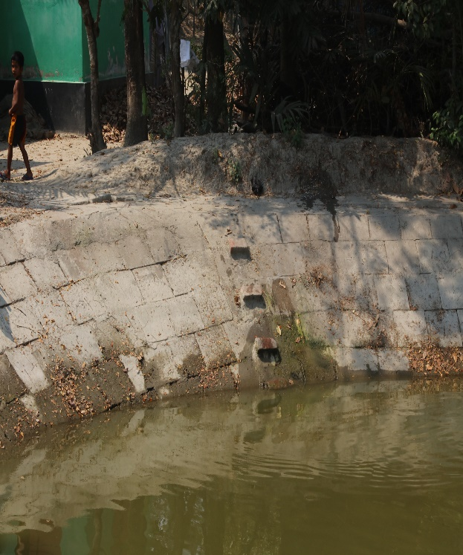
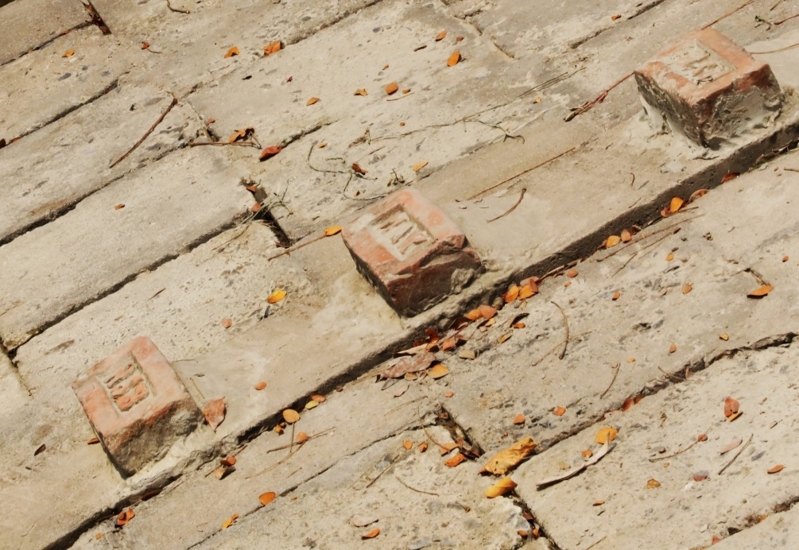
Water Level Gauge

